Slide 1


Slide 2


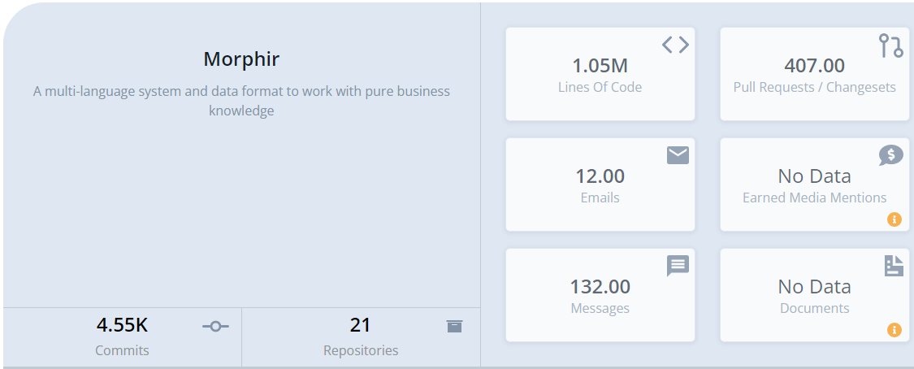
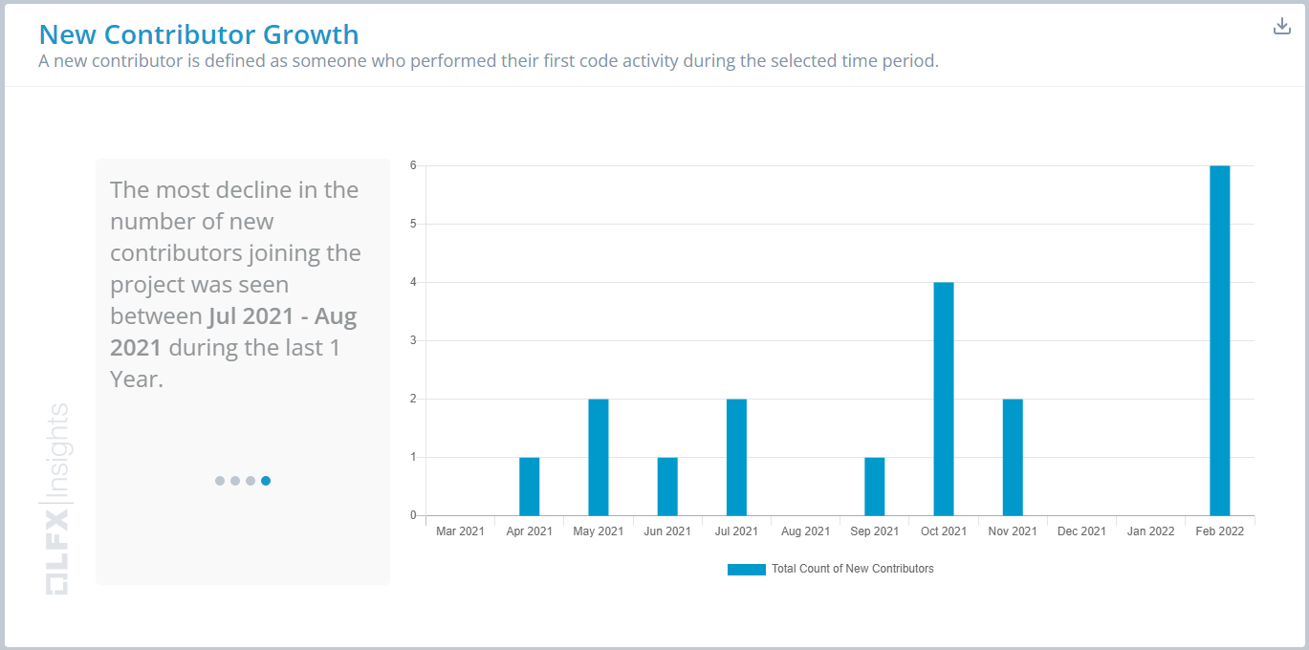
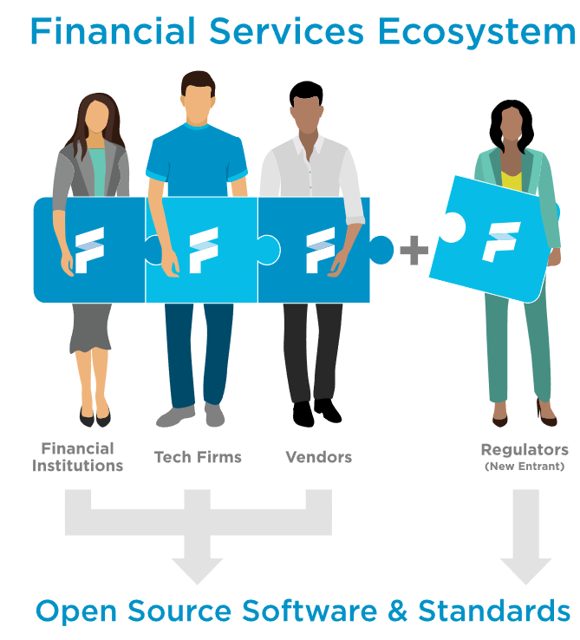

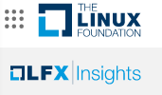
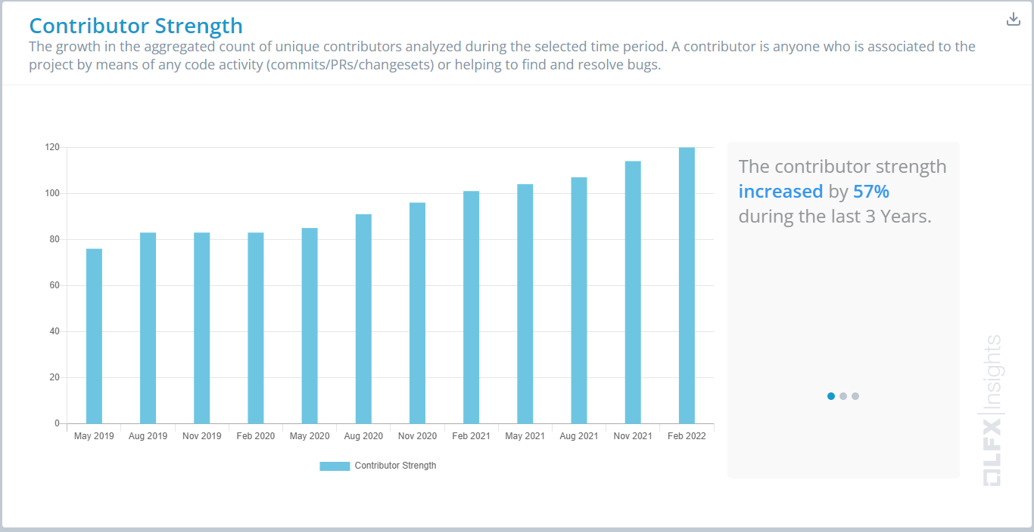

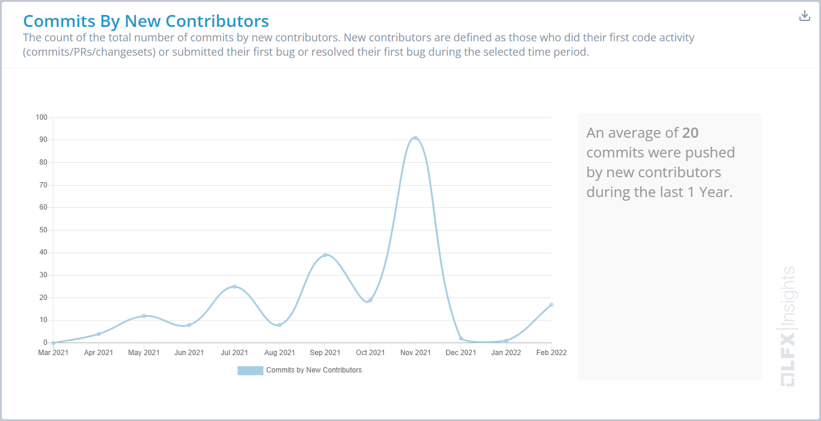
project
Stephen Goldbaum
Morgan Stanley Executive Director

Slide 3
FINOS Open Reg Tech
Digital Regulatory Reporting
Open-source foundations for distributing regulations as code.
Inclusive of financial institutions, tech firms, vendors, and regulators.
Facilitate integration and innovation by establishing an open ecosystem.
Industry Regulatory Ontology
Understand relationships across global regulations
Answer compliance and ownership questions
Increase industry efficiency
Compliance and Crime Prevention
Share and collaborate in a dynamic and critical area

Slide 4
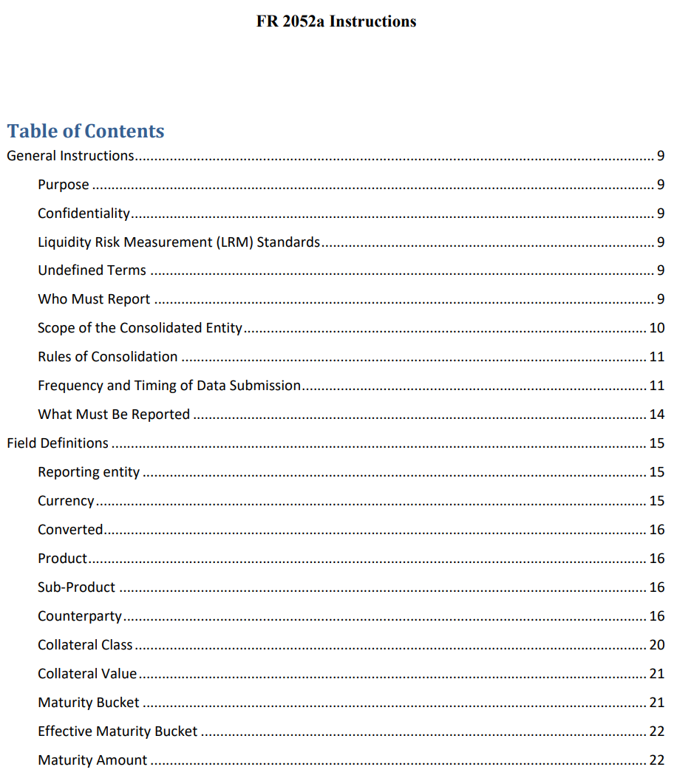
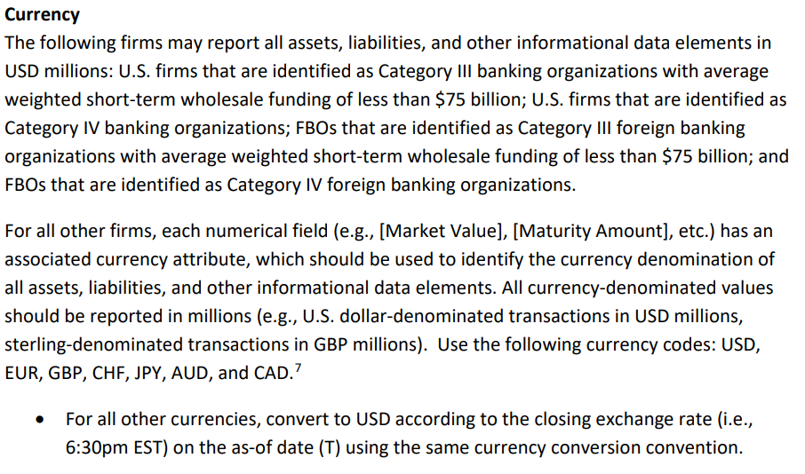
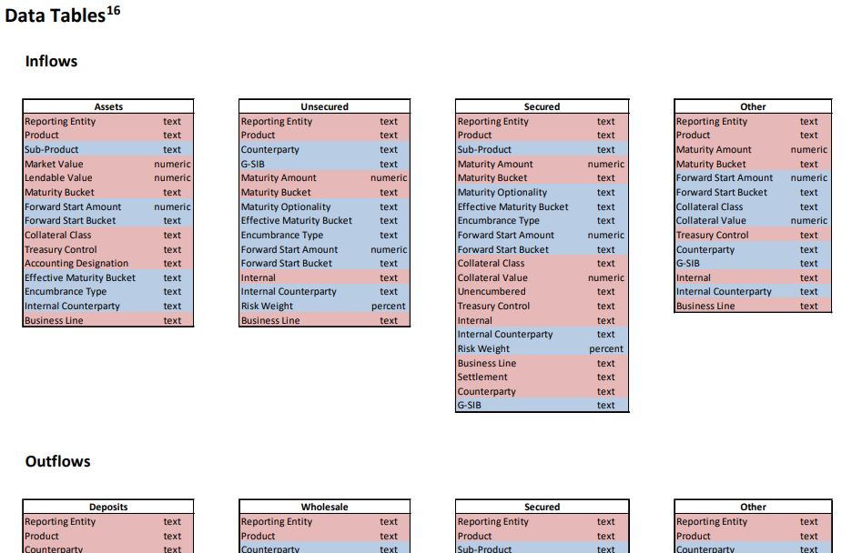

Current Regulation Pipeline
FR-2014-10-10
2052a Instructions
Basel-III-LCR-Formulas
Interpret
Document
Analyze
Architect
Implement

Slide 5

Digital Regulatory Reporting (DRR)
Interpret
Document
Analyze
Architecture
Implement
Interpret
Document
Analyze
Architecture
Implement
Interpret
Document
Analyze
Architecture
Implement
Interpret
Document
Analyze
Architecture
Implement
Interpret
Document
Analyze
Architecture
Implement

Slide 6
Digital Regulatory Reporting (DRR)
Interpret
Document
Analyze
Architect
Implement

Slide 7
Challenges to attaining DRR
Expressive enough for complexity
Accessible across technologies and stakeholders
Future proof
Transparent
Inclusive of varied stakeholders

Slide 8
Utilizing the FINOS Ecosystem
Goal: Foundation for open-source delivery and execution that is inclusive of current and future technologies.
Coding the LCR (Morphir)
Holistic
Adaptable
Transparent
Integrated
Verifying Correctness (Bosque)
Ensure correctness
Executing (Spark)
Performant
Scalable
Cloud ready
Integrating firm data (Legend)
Flexible
Fully catalogued and documented

Slide 9
Morphir Overview

Slide 10

Morphir Motivation
Industry-wide Transformation
Increased Transparency
Risking business to tech upgrades
Better data access
Eliminates technical debt risk
Increase agility
Ensures correctness
Disseminates knowledge through automation

Slide 11
Where Morphir Fits
Business Logic Frontends
Backend Targets
Programming Language (Elm, Bosque…)
Code (Scala, TypeScript…)
Domain specific languages
Data Processing
(SQL, Spark…)
GUI tools and more…
Other…

Slide 12






FINOS Reg Platform Ecosystem Pilot
1. Create
2. Verify
Bosque
3. Integrate
4. Execute
4. Understand

Slide 13
LCR
Widely known and used
Well documented
Medium sized
Complex enough to be a meaningful sample case
Simple enough to comprehend
Non-competitive
2052a Instructions

Slide 14
Creation: Spec

Slide 15
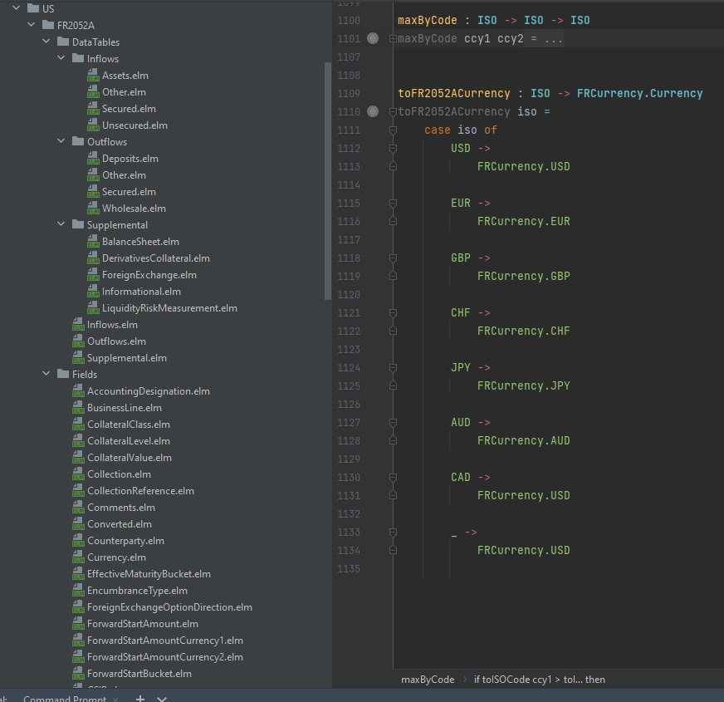
Creation: Spec = Code / Code = Spec

Slide 16
FINOS Reg Platform Ecosystem Pilot
1. Create

Slide 17
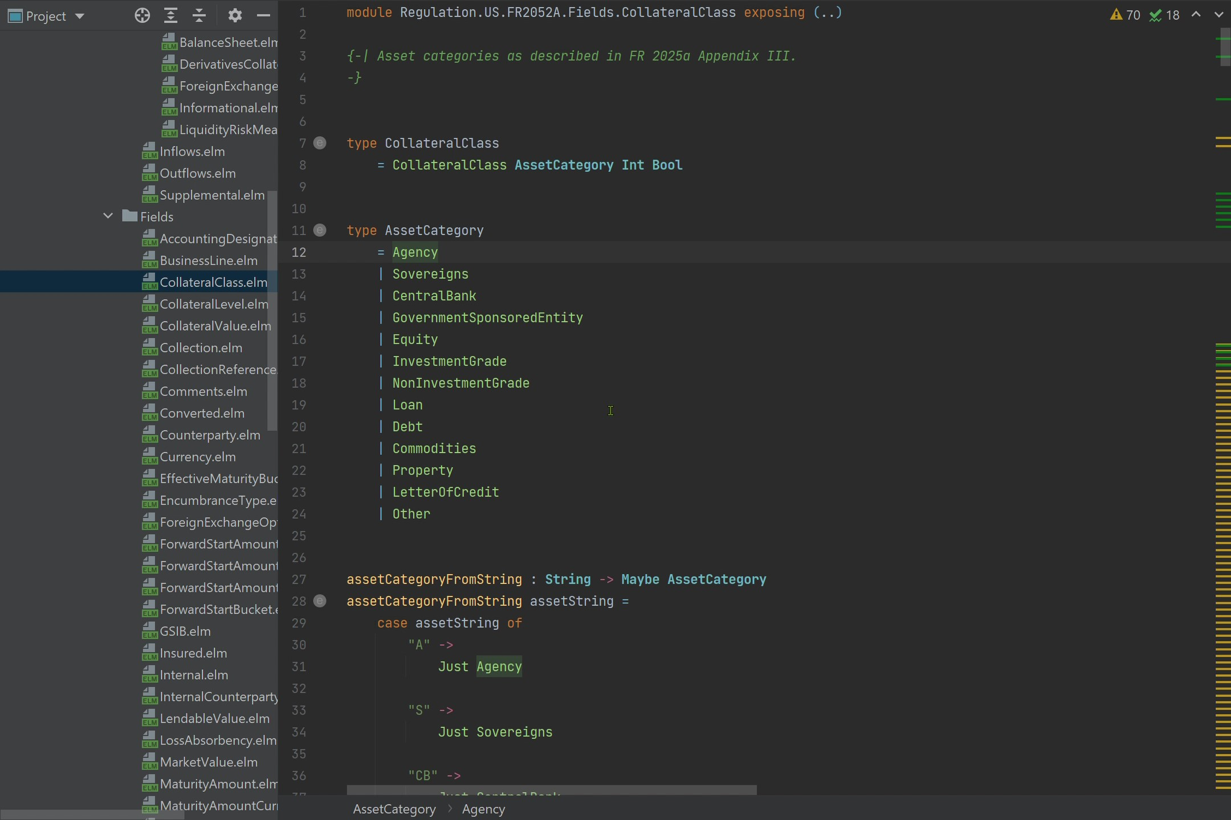
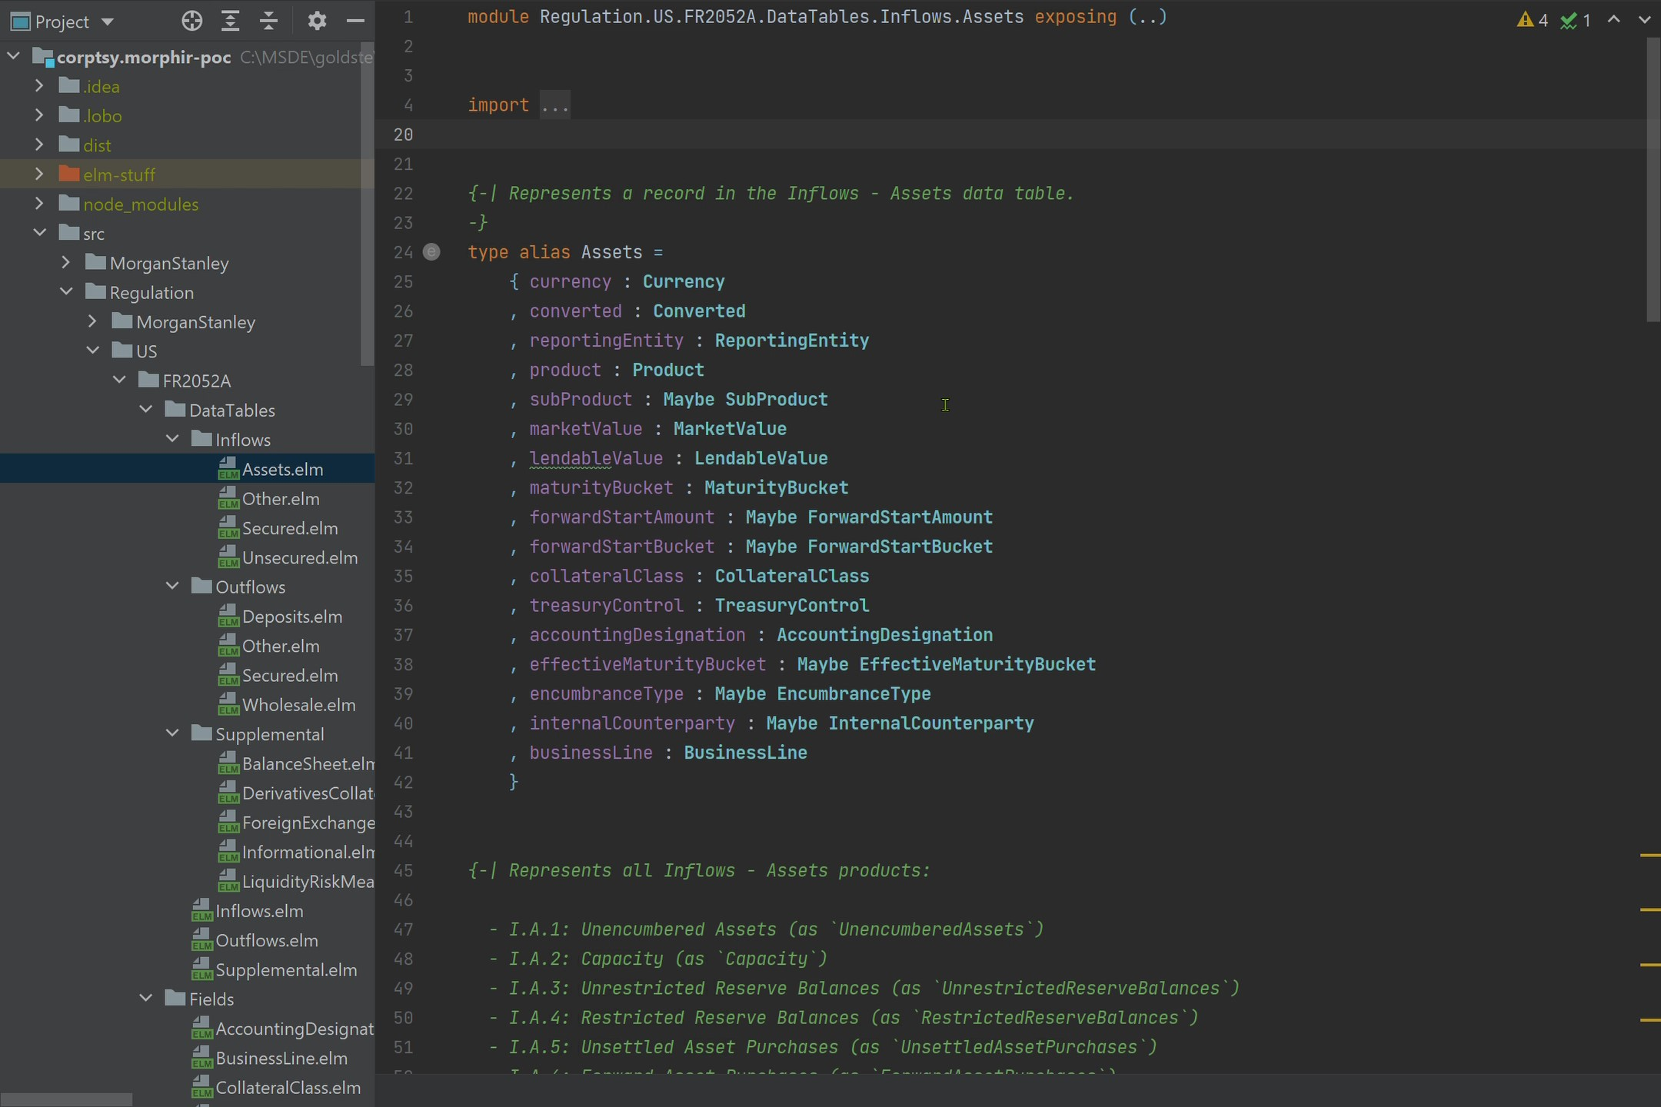
Creation: Elm
Open-source programming language

Slide 18






Creation: Open-source
Core Morphir
Elm
DSL
Open-source Community
Elm
Bosque
Legend
Scala
Rosetta
TypeScript
Bosque Programming Language

Slide 19
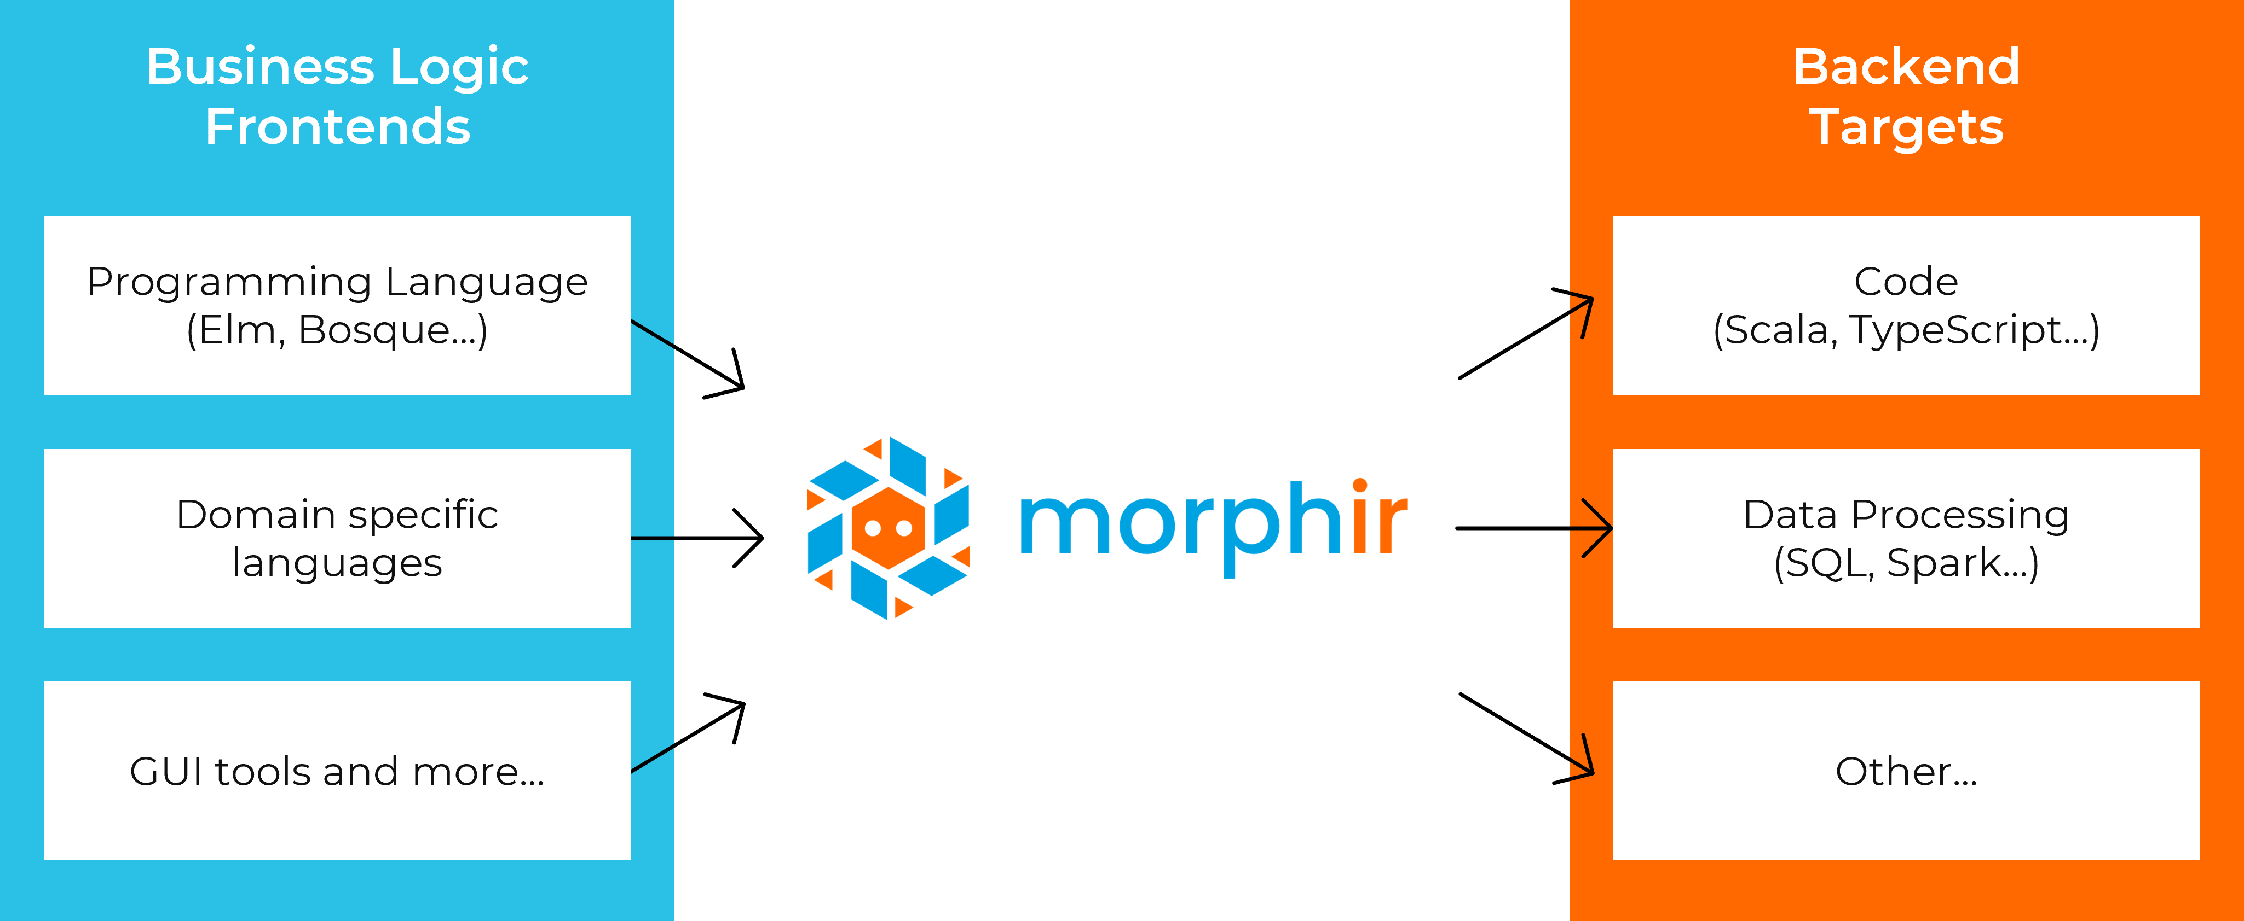
Creation: Other Open-source Ideas
SQL
ETL
DAGS (Spark, BEAM, Jet, etc.)
F#/OCaml
Rules engine DSLs
Excel
Low Code/No Code
…
There’s business logic in all of these. If we can extract it, we can do great things.

Slide 20
FINOS Reg Platform Ecosystem Pilot
1. Create
2. Verify
Bosque

Slide 21
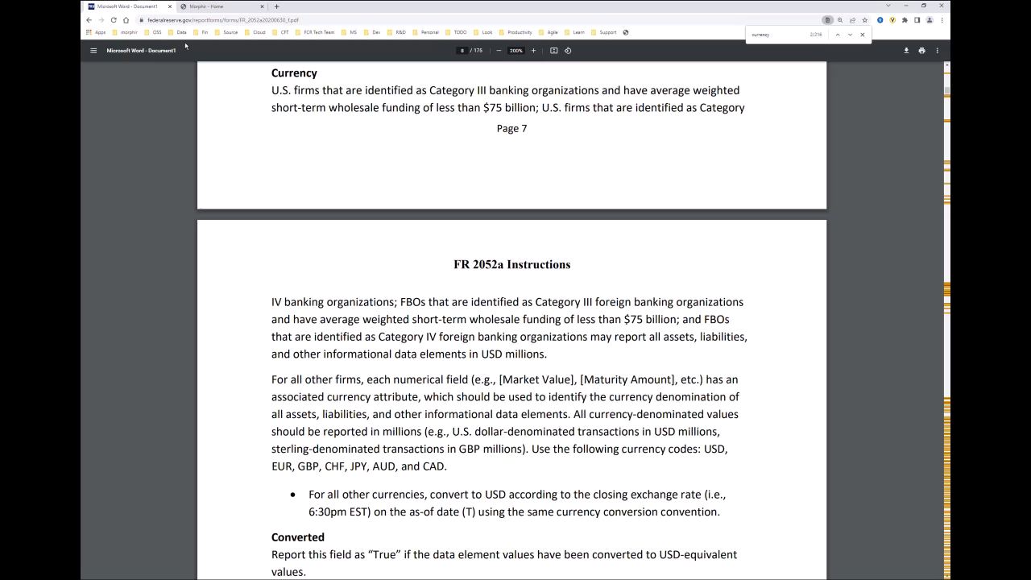
Quality: Interactive Tools

Slide 22
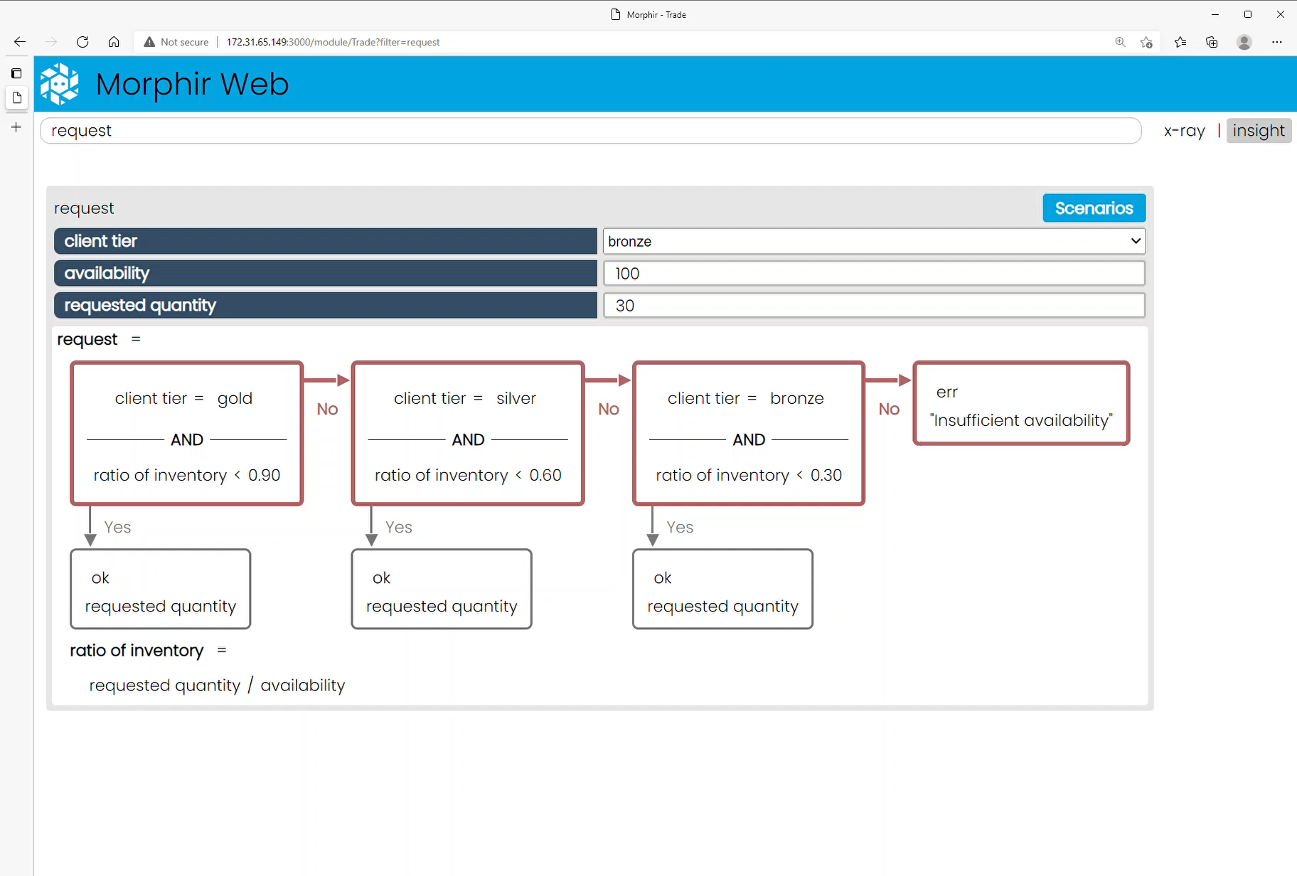
Knowledge: Audit
Why’d it do that?

Slide 23
FINOS Reg Platform Ecosystem Pilot
1. Create
2. Verify
Bosque
3. Integrate

Slide 24
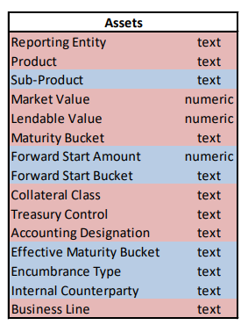
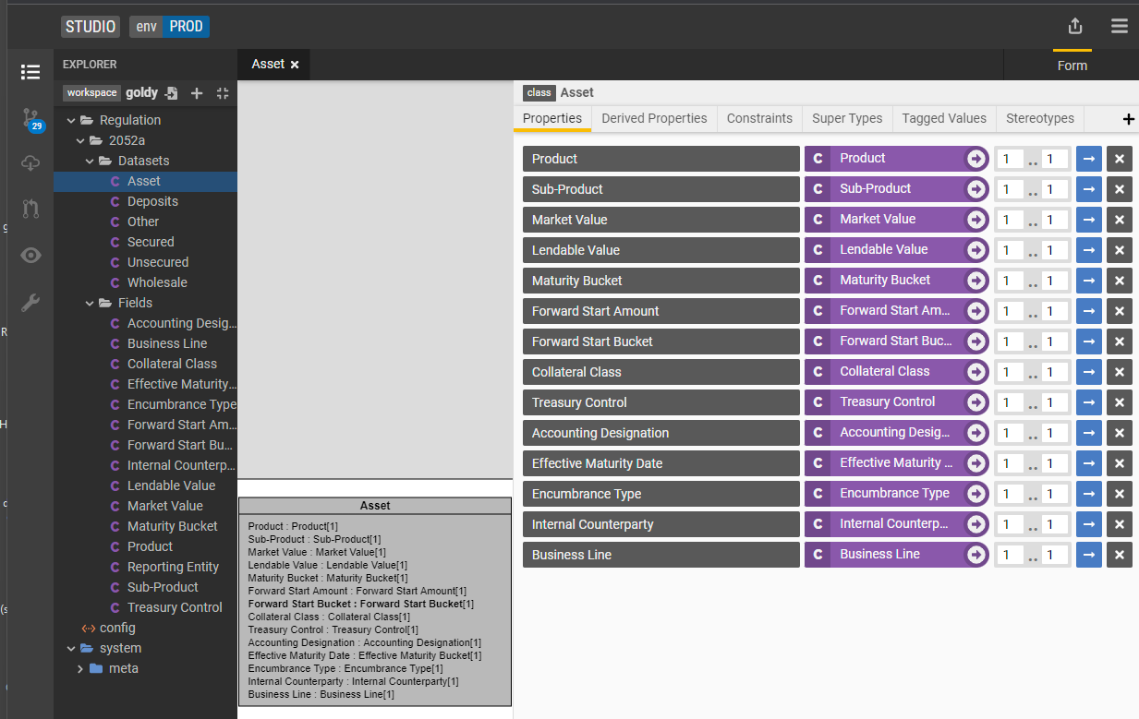
Integrating data from firm systems

Slide 25
FINOS Reg Platform Ecosystem Pilot
1. Create
2. Verify
Bosque
3. Integrate
4. Execute

Slide 26




Execution
Core Morphir
Scala/JVM
JavaScript
Interpreted
Spring
Open-source Community
Dapr
Spark
…

Slide 27
Holistic platform with FINOS ecosystem

Slide 28
FINOS Reg Platform Ecosystem Pilot
1. Create
2. Verify
Bosque
3. Integrate
4. Execute
4. Understand

Slide 29
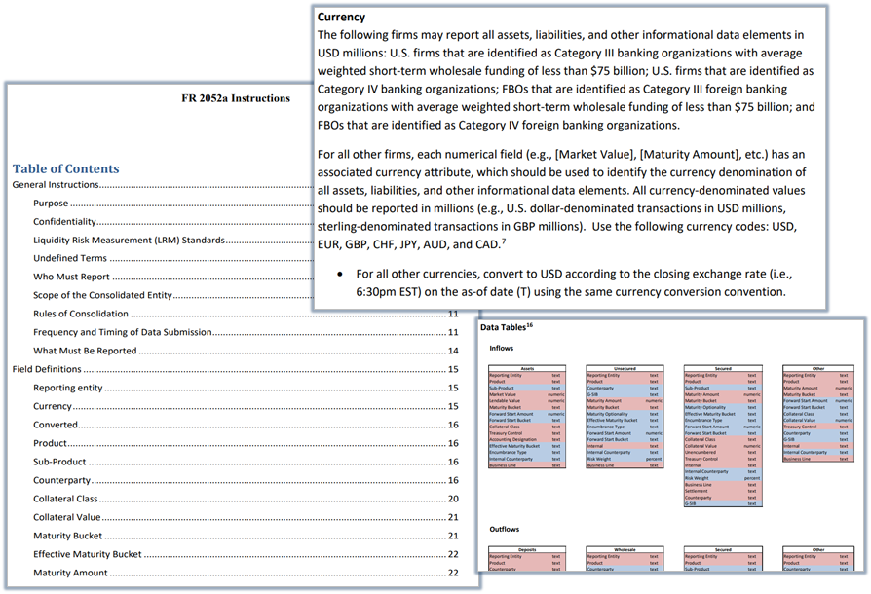
Knowledge: Pure Business Logic

Slide 30
Anti-knowledge: Impure Business Logic
Notes:
Fragmentation
Business users can’t understand from code
Neither can we!
Forensics exercise

Slide 31
Knowledge: Pure Business Logic

Slide 32

Quality & Knowledge
Core Morphir
100% Pure business logic
Insight
Test
Audit
Graph
Open-source Community
Elm/functional compiler
Bosque verification
Legend/Morphir/Bosque integration project
POPL 2022 Conference and Paper
Bosque Programming Language

Slide 33
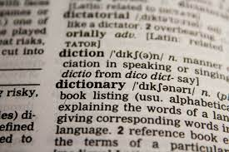
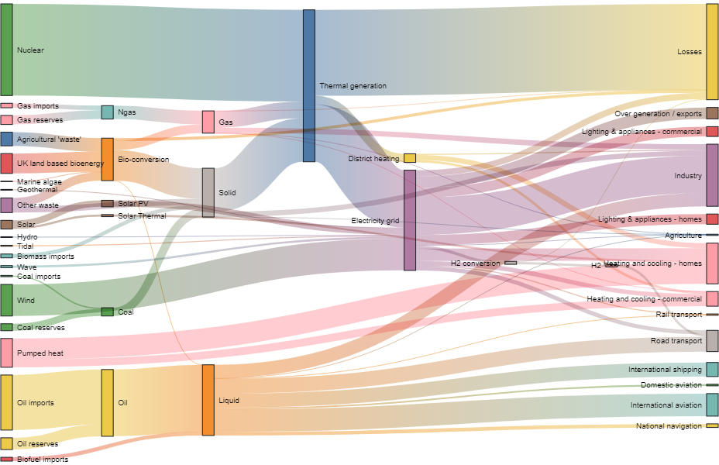
Integration
Data Dictionary
Data Lineage
Data Quality

Slide 34
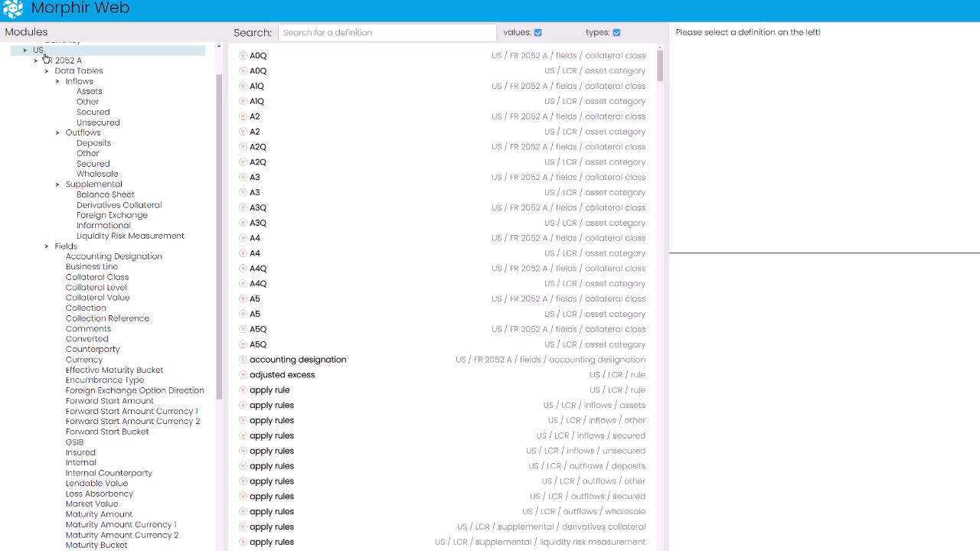
Integration

Slide 35
Exciting Developments
Execution in Spark
Active collaboration with Databricks
Authoring with Rosetta
Successful tech sprint in Q2 with REGnosys
Authoring with Scala
Active collaboration with Capital One
Integration with Legend
Collaboration with Goldman Sachs and Microsoft

Slide 36
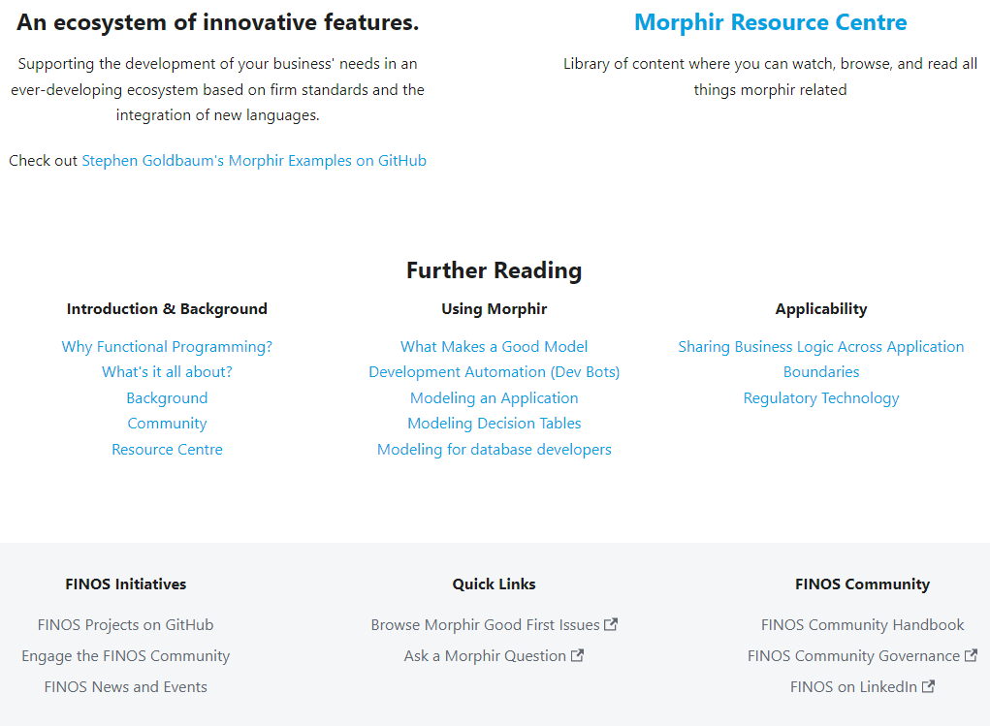
Open-source Success
Incredible partnerships
Incredible potential
Roadmap
Execution
Spark
Microservice
Creation
Scala and more…
Quality
More insight
More Bosque verifier
Integration
Data Management & Data Quality
Ontologies & semantic
Get Involved
Your creativity

